Slide 1
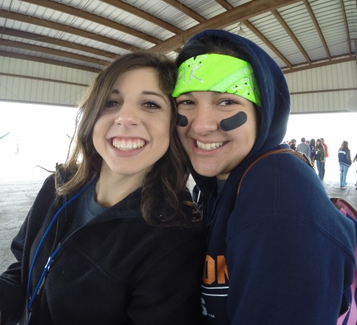
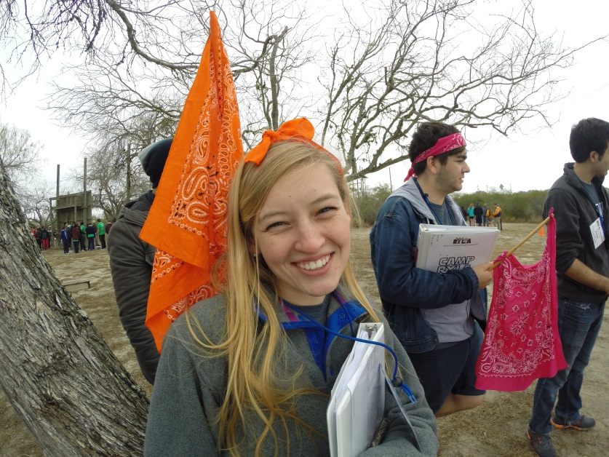
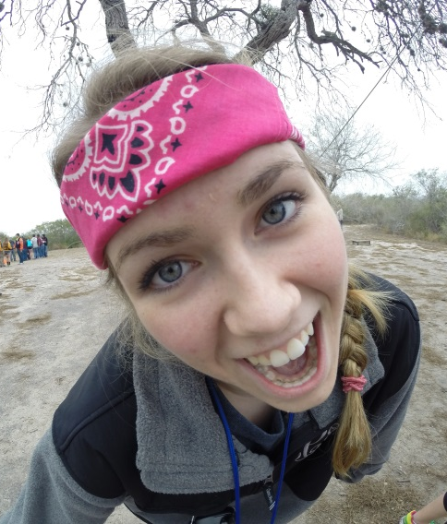

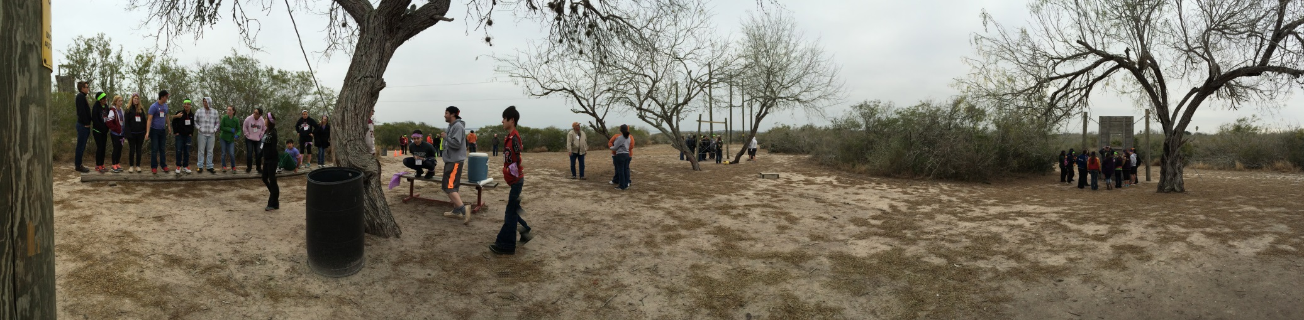

Slide 2
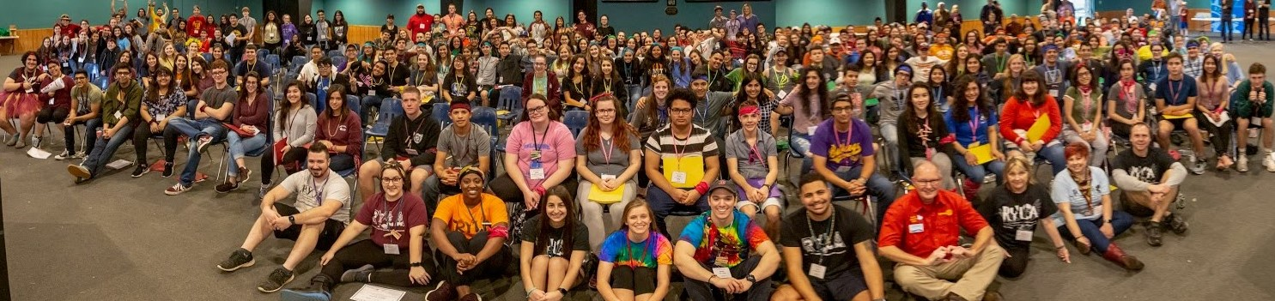
RYLA by the numbers
156 Campers (maximum accepted)
40 Trailblazers (2nd year campers)
15 Jr Counselor 1 (must complete service project)
12 Jr Counselor 2
12 Sr Counselors
16 Youth leadership staff

Slide 3
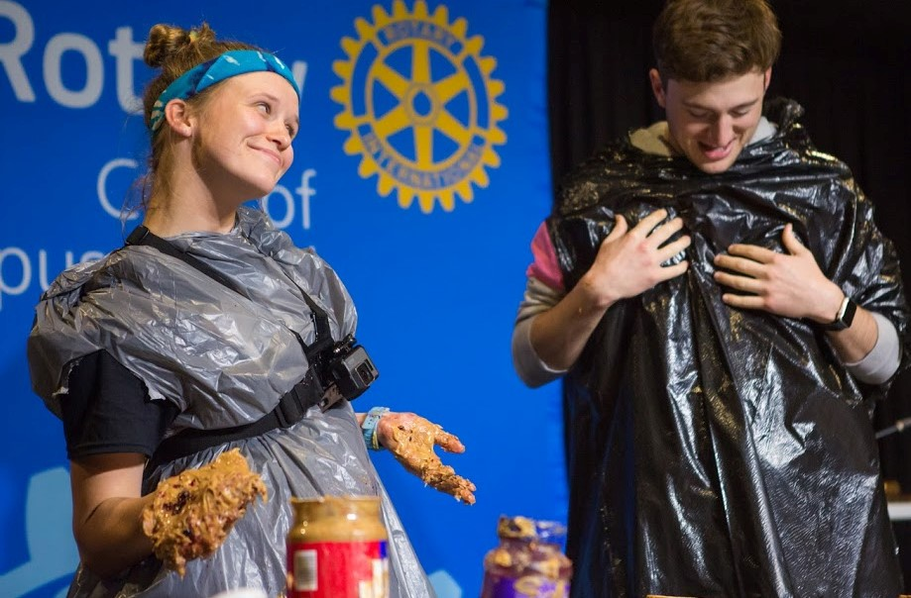
RYLA focuses on
Communication styles and personality profiles

Slide 4
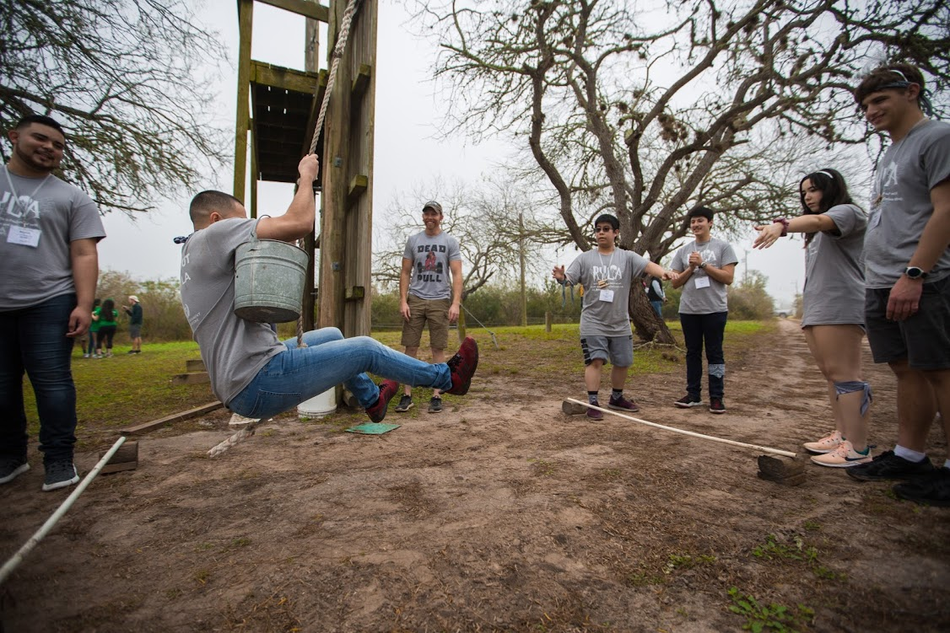
Experiential learning

Slide 5
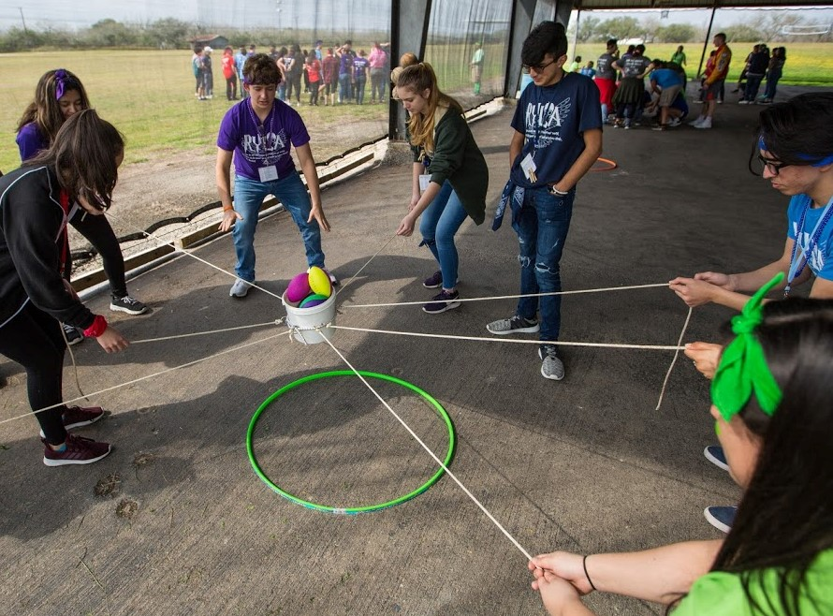
Critical thinking skills and team decision making

Slide 6
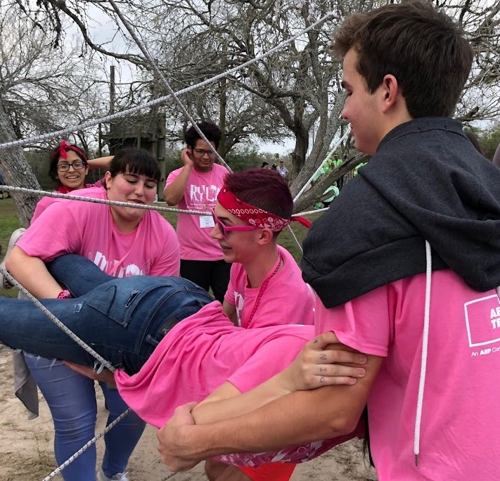
Emphasizing positive character traits like Trust And Support

Slide 7
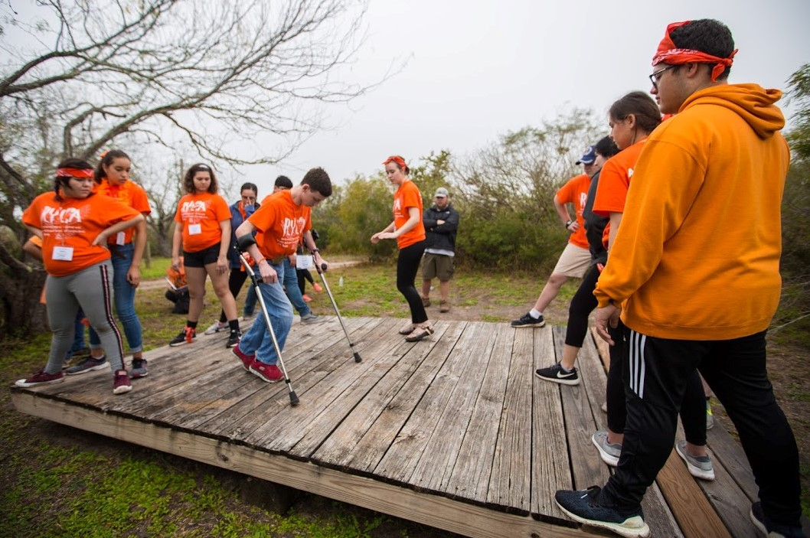
Creativity, problem solving and active learning

Slide 8
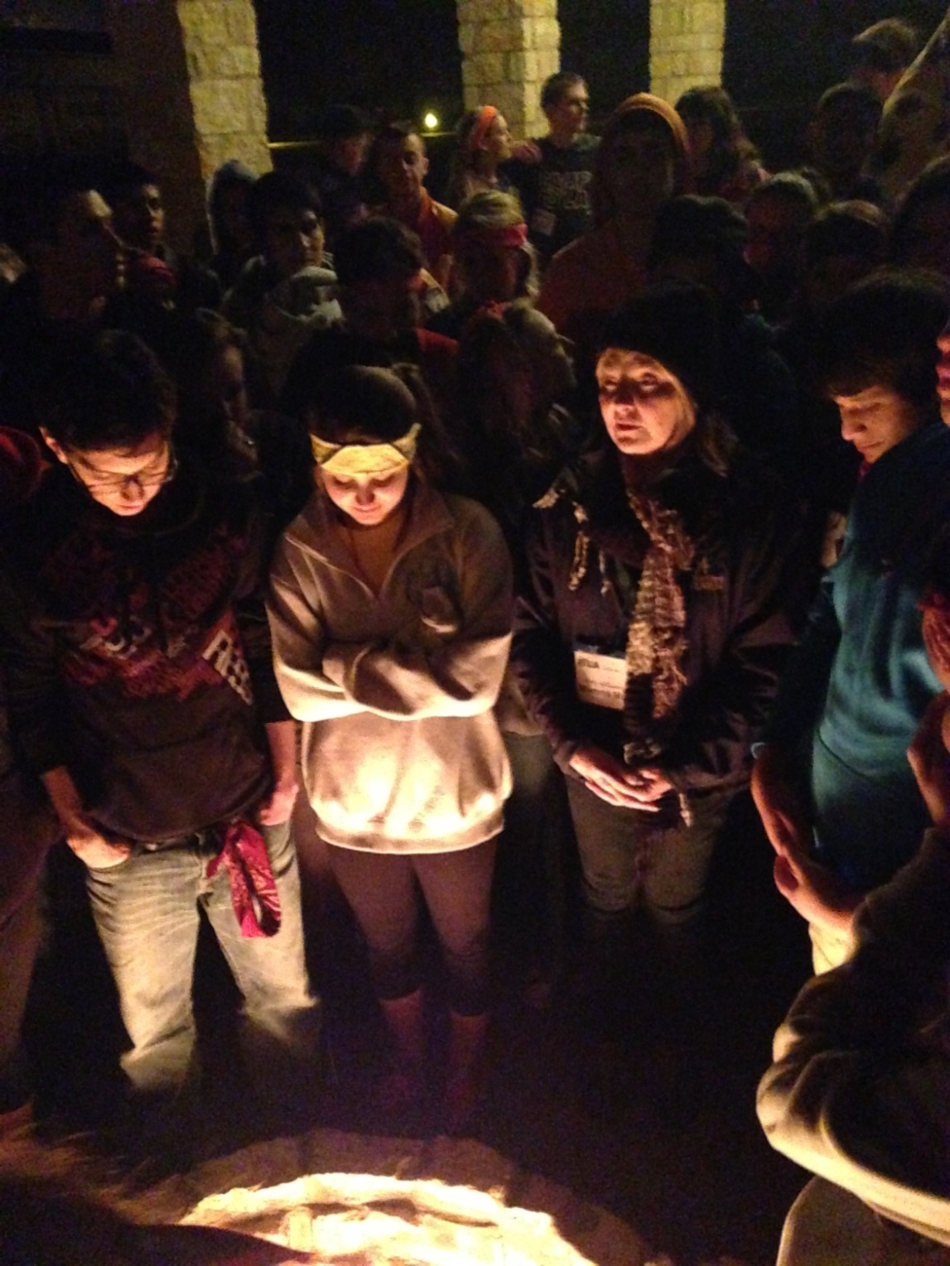
Time for reflection and sharing

Slide 9
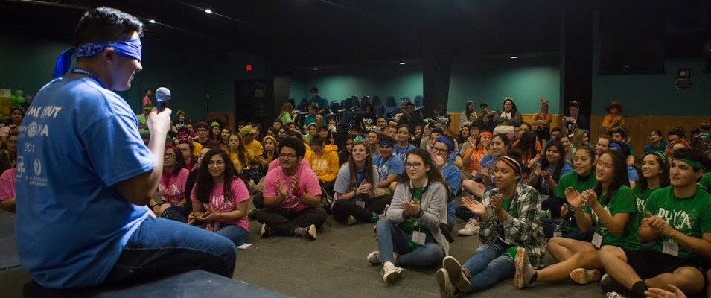
High impact: In their own words…

Slide 10
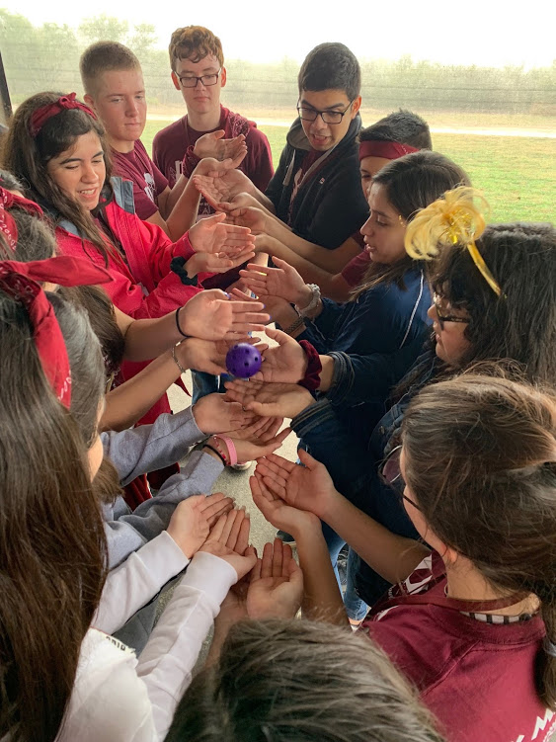
“My weekend at RYLA was by far the best weekend of my life. I met so many new people, and learned so many new things about leadership and about myself. RYLA has changed my life.”
– Camper

Slide 11
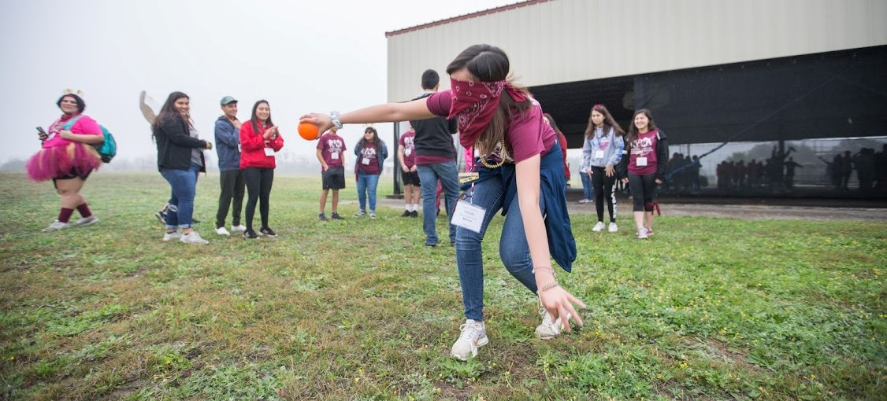
“I’ve experienced so much in such a small amount of time, that I am stunned. I’ve attended 3 leadership camps and this was the best camp EVER! Honestly and from the bottom of my heart, no other experience compares to RYLA.” – Camper

Slide 12
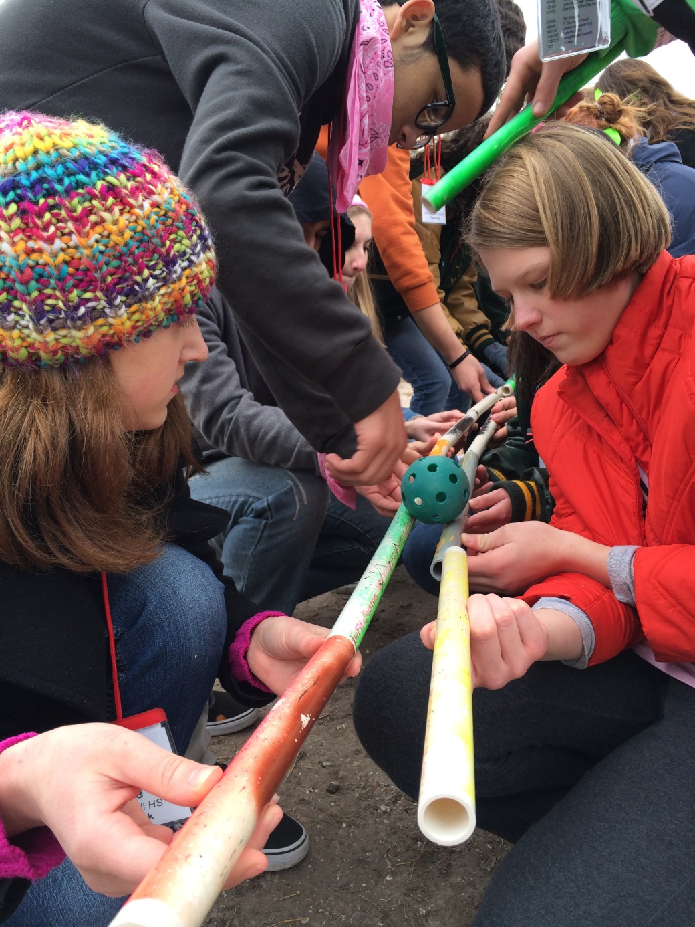
“The Labyrinth was such an amazing experience. It makes you think about what really matters to you and what you shouldn’t worry about.”
Camper

Slide 13
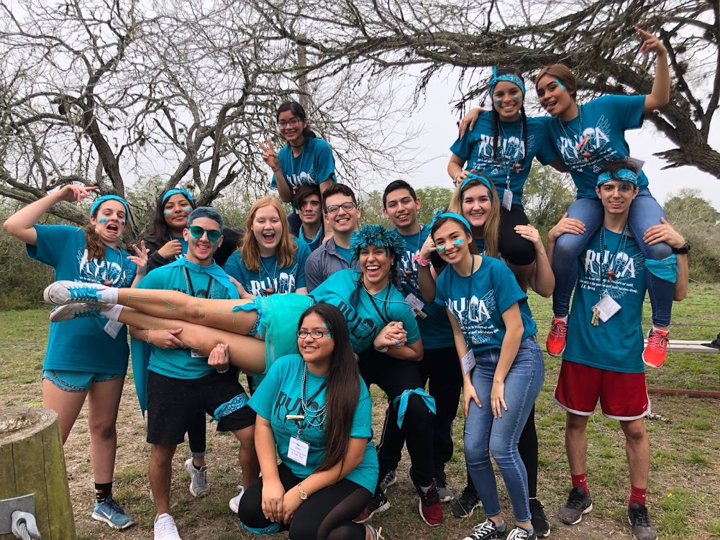
“Never have I met so many people in my life that I want to stay friends with forever and I hope I get to go back next year!” -- Camper

Slide 14
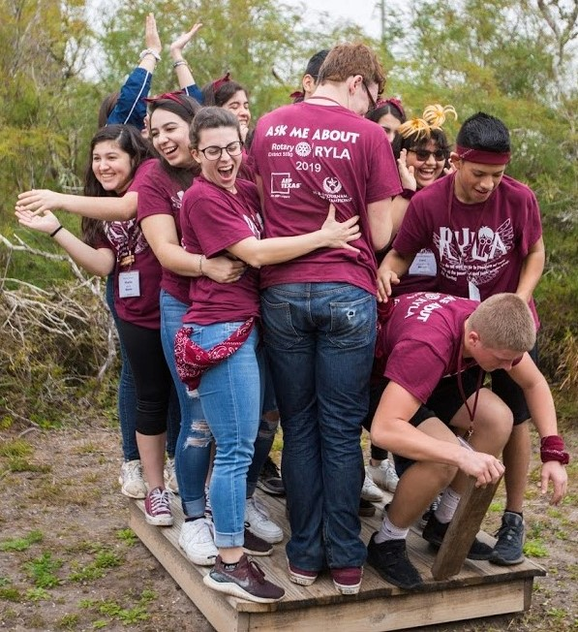
“Coming into contact with myself face to face was pretty scary, but it helped me mentally and physically. Everybody deserves a chance to feel like they are worth something and that’s exactly what RYLA gave me.” – Camper

Slide 15
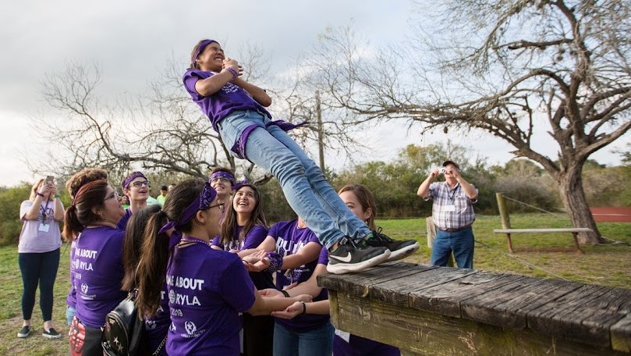
“My daughter Taylor attended your conference this past weekend…

Slide 16
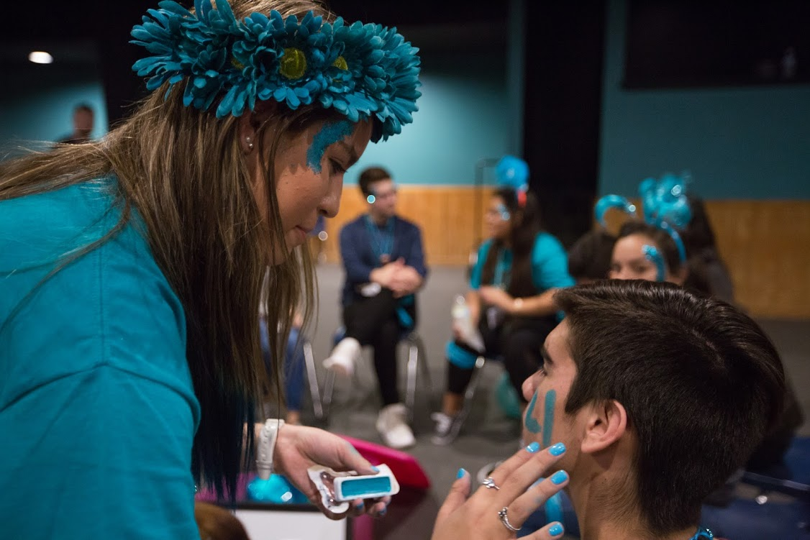
“Her first comment to me as she got off the bus was, “That was the greatest experience of my life.”
Needless to say, I was taken aback for a moment...

Slide 17
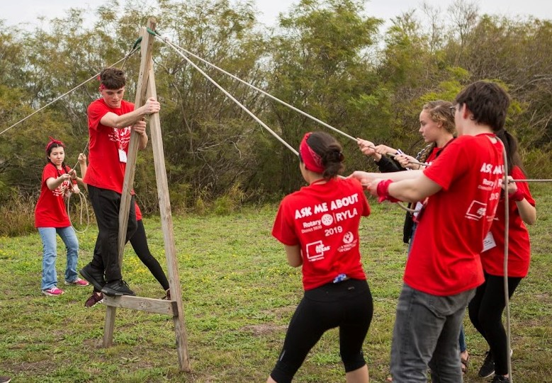
“She had never had opportunities to reflect on the past/present while systematically and purposefully planning for the future.
She absolutely loved this retreat.

Slide 18
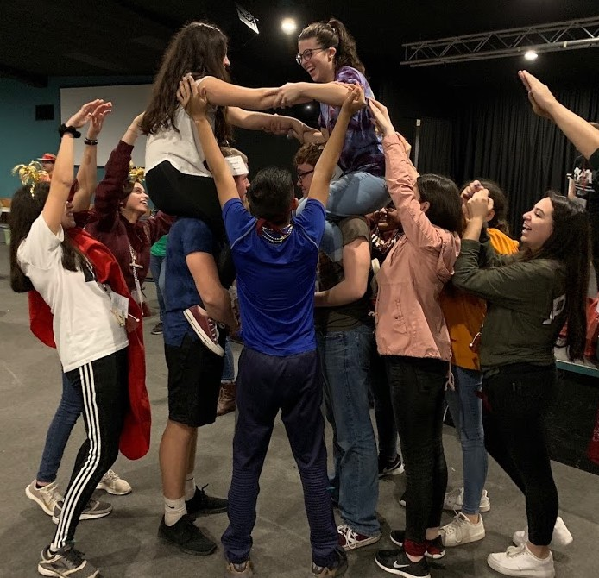
“I just wanted to … say THANK YOU to you, your staff, and your organization for creating
such a meaningful, insightful and focused youth leadership experience.”
Mr. John Gray, Principal
Jo Nelson Middle School
Santa Rosa, Texas

Slide 19
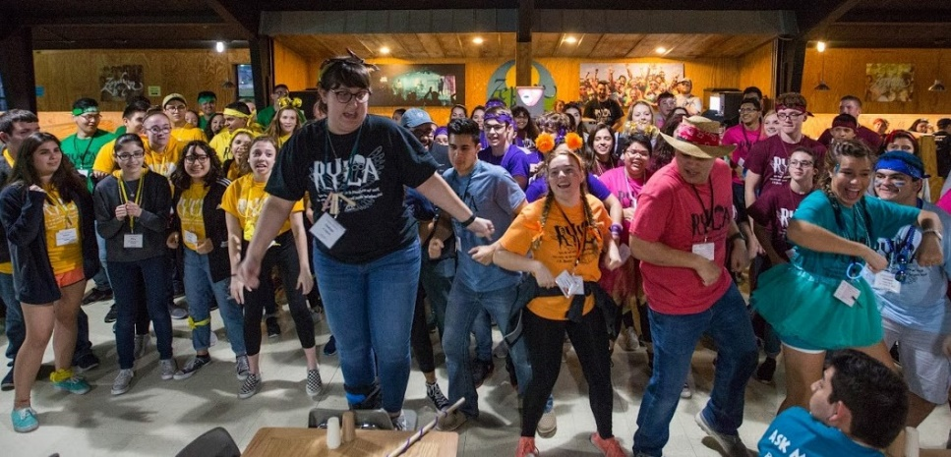
RYLA: Empowering our Youth
An experiential leadership camp to empower youth to believe in themselves and give back to their communities.

Slide 20
RYLA 2020: Jan. 31-Feb. 2
Campers
Check in for campers: 10:30-11:30 AM, Friday, January 31, 2020
Camp starts: 11:15 AM, Friday, January 31, 2020
Closing ceremonies: 10:00-11:00 AM, Sunday, February 2, 2020
Dorm check out: 11:30 AM, Sunday, February 2, 2020
Students may need to be excused from school for the full day on Friday
Contact the Rotary Club of Corpus Christi at rotarycc@swbell.net or 361-882-8672 for school excuse letters if needed
Start/end time will affect bus schedules from the Valley and Laredo, please plan accordingly
Special Notices

Slide 21
RYLA 2020: Jan. 31-Feb. 2
Applications Deadlines and Fees
Application & Payment received by 11/27/19 $300/camper
Application & Payment received between 11/28/19 and 1/10/20 $325/camper
Alternate Applications must be received by 1/10/20 N/A
Trailblazer sponsorship (optional) must be received by 12/9/19 $300/Trailblazer
Special Notices
RYLA camper registration is capped at 156; get your campers registered AND paid as early as possible to reserve their spot. It is highly suggested that no more than 4 campers per school attend to create diversity throughout the District
Applications that are INCOMPLETE or NON-PAID as of 1/10/20 will not be accepted and those campers cannot be placed in teams
No invoice will be sent – this schedule is your chart for payment
Applications should be scanned and emailed to rotarycc@swbell.net
Fees should be mailed to Rotary Club of Corpus Christi, 921 Chaparral, Ste. 210, Corpus Christi, TX 78401
Once RYLA applications are at capacity, applicants accepted will be considered alternates waiting to be assigned teams as spaces open up

Slide 22
RYLA 2020: Jan. 31-Feb. 2
Alternates
No fees are due for Alternate application submissions
Alternate applications must be in the RYLA Office (Rotary Club of Corpus Christi) by 1/10/20 to be considered as viable Alternate Campers
Alternate applications must be in RYLA office at time of substitution request as the program cannot wait for additional submissions
No Alternate substitutions will be made after 1/20/20
While not guaranteed, many past Alternates were able to attend RYLA under sponsorship of some Club
Cancelations/Refunds
Registrations can be cancelled with 100% refund through 1/10/20
No refunds for cancellations after that date or for no shows at camp
Fees can be applied to an Alternate applicant.
Alternate applications from other clubs can be used if no Alternate applications were submitted by your club

Slide 23
RYLA 2020: Jan. 31-Feb. 2
Trailblazers = $300 fee
Student’s are currently responsible for their Trailblazer $300 fees
Student’s may pay directly, raise funds or seek sponsors for their fee
Club sponsorship of Trailblazers is optional
If Clubs choose to sponsor a Trailblazer, the final payment date is December 9, 2019. After that date, the Trailblazer is dropped from the roster if their fee is unpaid
There is a separate “invitation only” application for Trailblazers.
Trailblazer applications are due 11/27/19
Potential Trailblazers must have attended RYLA as a camper.
For Trailblazer information, contact Mary McQueen, mmcqueen2@delmar.edu, 361-815-1157.

Slide 24
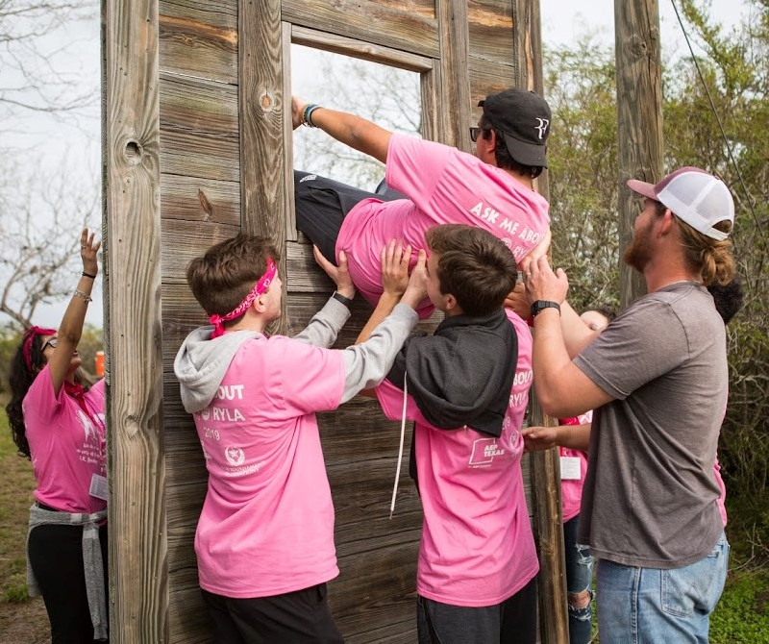
RYLA 2020: Jan. 31-Feb. 2
This year will be RYLA’s 25th Anniversary. We hope to see your sponsored campers at RYLA 2020!

